Slide 1

TAMPA BAY REAL ESTATE
Q4 2026 Market Update
Brittany Morales | SunCoast Realty Group October 2026

Slide 2
Market at a Glance
Tampa Bay Residential | October 2026
$1.83M
YTD Closed Volume
4 transactions closed
$1.20M
Active Pipeline
3 listings + 3 buyer clients
+4.1%
South Tampa YoY
Median price growth
22 days
Westchase Avg DOM
Fastest market in portfolio
South Tampa and Westchase continue to outperform heading into Q4. Channelside offer expected to close October 18. Westchase open house October 17 generated five qualified leads with the Nguyen family showing strong interest.

Slide 3
Neighborhood Breakdown
Comparative market metrics | Tampa Bay | October 2026
Neighborhood | Median Price | Avg DOM | Price/SqFt | Active | YoY
Hyde Park | $712,000 | 26 days | $358 | 39 | +4.7%
South Tampa | $565,000 | 28 days | $312 | 142 | +4.1%
Westchase | $548,000 | 22 days | $241 | 48 | +5.0%
Carrollwood | $438,000 | 30 days | $219 | 57 | +2.6%
Seminole Heights | $392,000 | 34 days | $268 | 61 | +3.2%
Channelside | $298,000 | 41 days | $252 | 73 | +1.8%

Slide 4
Median Sale Price by Neighborhood
October 2026 | Source: Brittany Morales market research

Slide 5
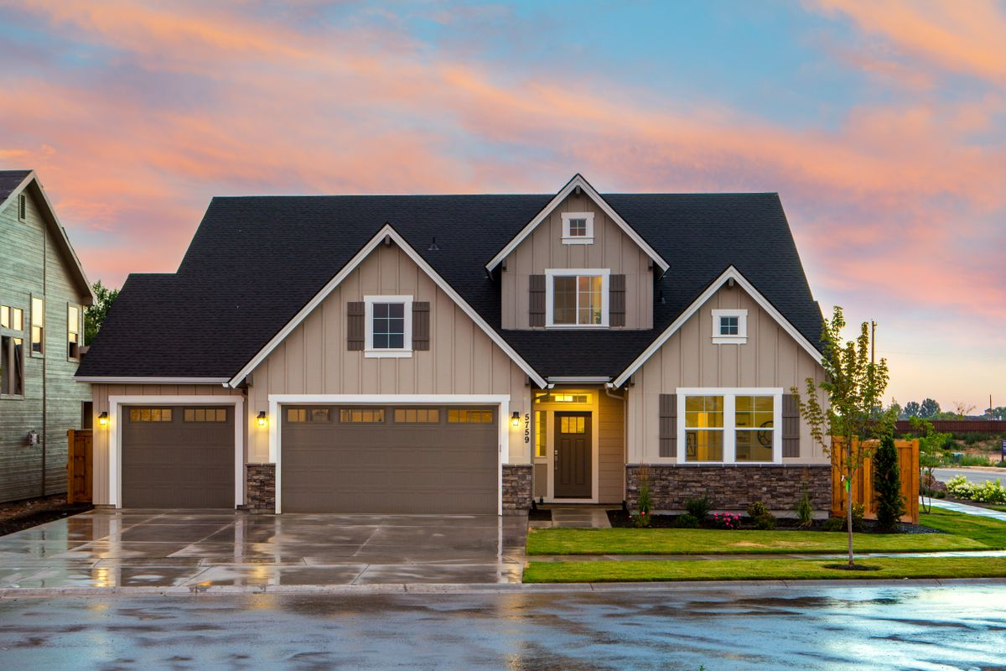
Active Listings
Three properties under Brittany Morales, SunCoast Realty Group
12508 Westchester Estates Dr | Westchase
$525,000 | 4/3 - 2,760 sqft | Active - 9 DOM
Open house Oct 17. Pre-listing inspection clean. Nguyens interested at asking.
1014 E Frierson Ave | Seminole Heights
$389,000 | 3/2 - 1,540 sqft | Active - 272 DOM
Price reduction review pending. Petersons at $350K. Gap needs bridging.
1120 E Kennedy Blvd #814 | Channelside
$285,000 | 2/2 - 1,180 sqft | Offer Pending
CMA supports $285K. Offer under review. Estimated close October 18.

Slide 6
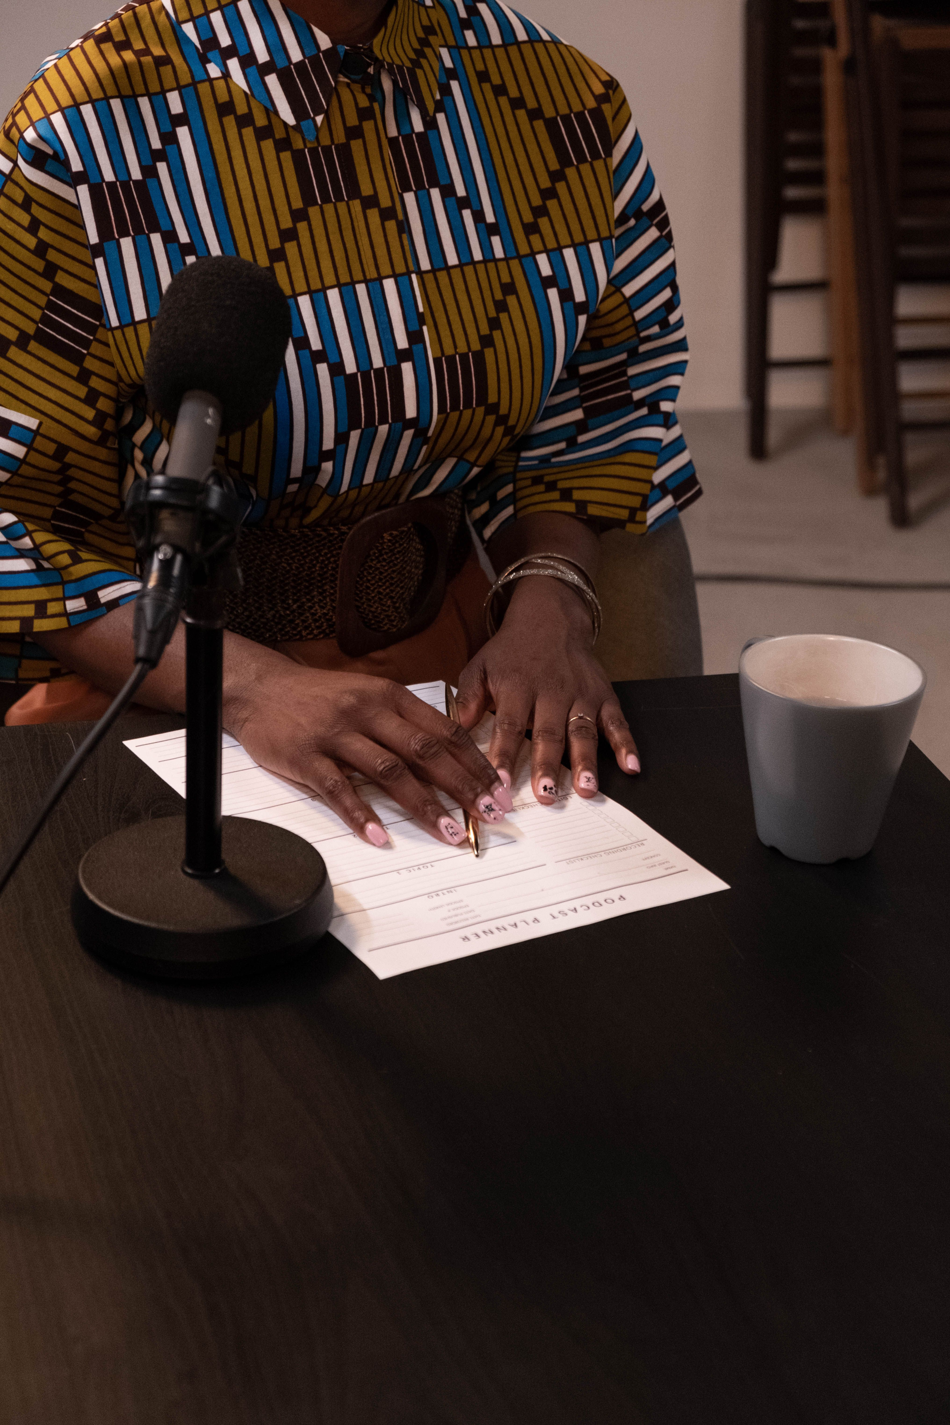
Active Buyer Pipeline
Petersons | Budget: $350,000 | Pre-approved
Areas: South Tampa, Seminole Heights | Needs: 3BR min
Next: First-time buyers. Showed Frierson Oct 12. Pull comps, schedule call.
Nguyens | Budget: $500,000 | Pre-approved
Areas: Westchase, Carrollwood | Needs: 4BR, top school zone
Next: Attended Westchase open house Oct 17. Loved it. Discuss offer strategy Monday.
Dr. Ramirez | Budget: $450,000 | Pre-approved
Areas: Channelside, Bayshore | Needs: Waterfront required
Next: Relocating from Miami. Toured Channelside #814. Compare waterfront options.

Slide 7
Year-to-Date Performance
YTD Summary
Closed Volume: $1,834,500
Transactions: 4 closings
Net Commission: $36,690
:
Annual Goal: $5,000,000
Volume Gap: $3,165,500
:
2024 Personal Best: $4.2M
Q4 Outlook: Strong pipeline

Slide 8

Q4 Focus and Priorities
1
Close Channelside #814 by Oct 18
Offer pending. Coordinate with title. Confirm seller availability.
2
Convert Nguyen interest to offer
Follow up Monday Oct 20. Discuss Westchase offer strategy.
3
Price review on Seminole Heights
272 DOM. Meet sellers to discuss reduction toward $375K.
4
Hit $3.5M volume by November 30
Close Westchase and one buyer deal to stay on pace.
5
Instagram: 7,500 followers by Dec 1
Post daily stories. Reel from open house. Hire social manager.
Brittany Morales | SunCoast Realty Group | (813) 555-0119 | brittany.morales@Greenridertech.co

